Slide 1


New York Times Data Analysis
Using HIVE
CIS5200:03 | Project Group 4
Guided By: Prof Jongwook Woo | Submitted By: Bita faraji Jay joshi Shradha shinde

Slide 2
INTRODUCTION
Large number of readers
Shapes public opinion
Outlook on current affairs
Sets the tone of the public discourse
Comments sections give insights to readers’ opinions on the subject matter of the articles

Slide 3
GOALS
Analyzing most used Document Type and Type of Material.
Analyzing most Popular Author for the Articles.
Analyzing sentiments of people based on positive negative comments
Analyzing the recommendation's, news desk, reply, document type counts
Analyzing the highest reply count based on user location.

Slide 4
ABOUT DATASET
Dataset URL: https://www.kaggle.com/aashita/nyt-comments
Comments, Articles | 2017,2018 | Jan-May
Columns: Reply count, Comments, Month, User location, Article Word Count
Dataset Size: 1.5 GB

Slide 5
TECHNICAL SPECIFICATON
Cluster version: Hadoop 2.8.5-amzn-4
Cluster number of nodes: 3 nodes
Memory size(CPU speed): 2.20 GHz
HDFS Capacity: 147 GB
Storage: 678 GB
Hive Version: Hive 2.3.5-amzn-1

Slide 6

FLOW CHART

Slide 7

DATASET SOURCE
NEWYORK TIMES
DOWNLOAD CSV FILES
VISUALIZE
DATA CLEANING
STORE AND PROCESS DATA
QUERY

Slide 8
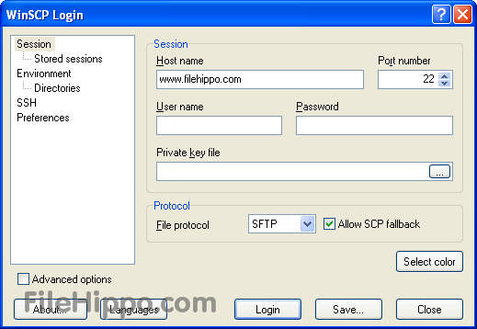
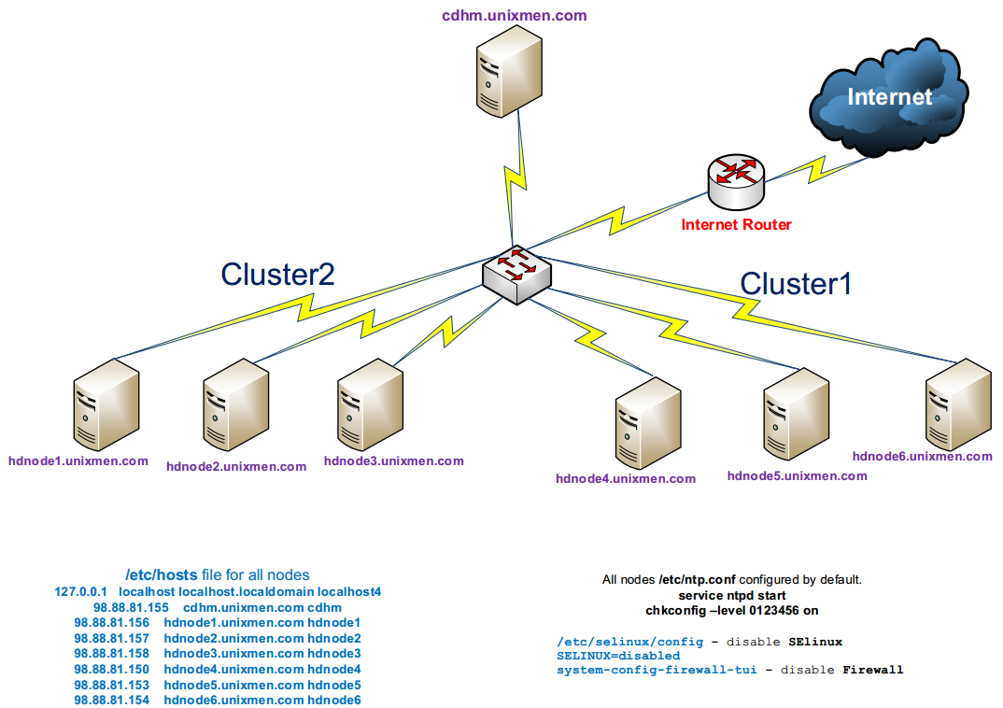



ARCHITECTURE
wget https://raw.githubusercontent.com/shradhacsula/Data-Project/master/ArticleYear2017.txt
wget https://raw.githubusercontent.com/shradhacsula/Data-Project/master/ArticleYear2018.txt
EMR
winscp commentyear2017
Winscp comment year 2018
ssh sshinde6@34.221.40.43

Slide 9

https://github.com/shradhacsula/5200-project

Slide 10
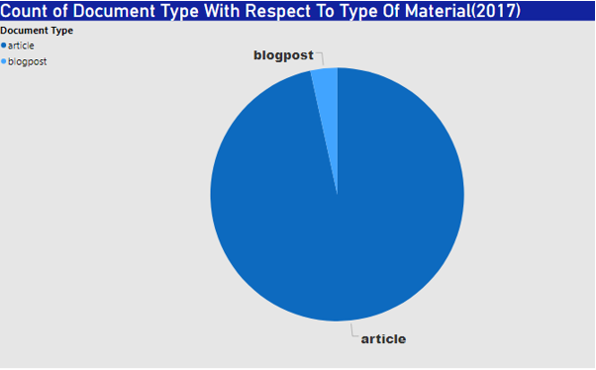
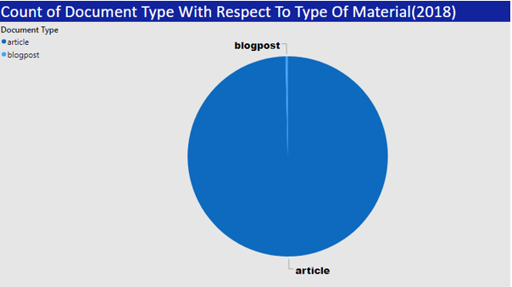
COUNT OF DOCUMENT TYPE/ TYPE OF MATERIAL
Maximum: Article: 4410, 3158
Minimum: Blogpost: 156, 11

Slide 11
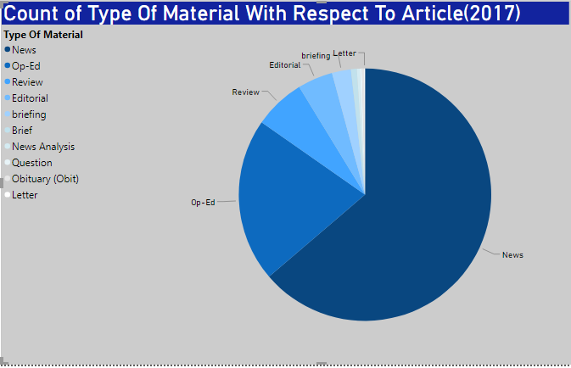
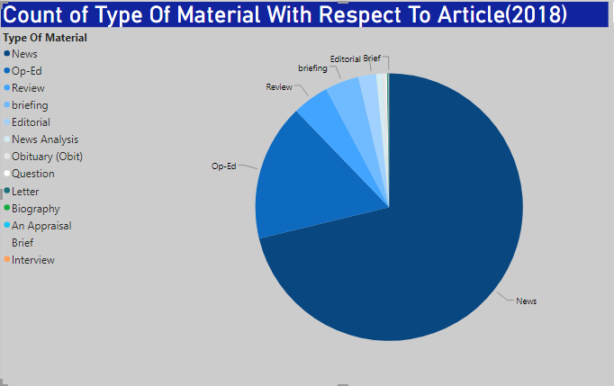
COUNT OF TYPE OF MATERIAL /ARTICLE
Maximum: News: 2811, 2249
Minimum: Letter: 6, 3

Slide 12
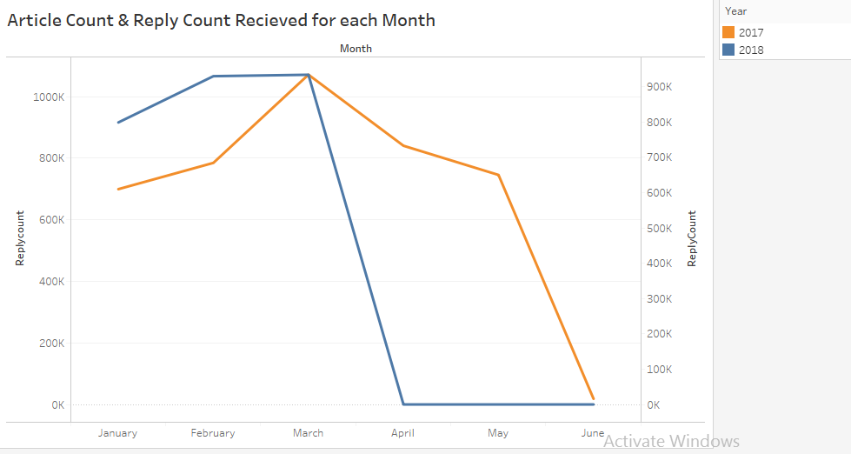
REPLY COUNT FOR ARTICLE MONTH WISE
Highest: March: 1071064
Least: May: 745638

Slide 13
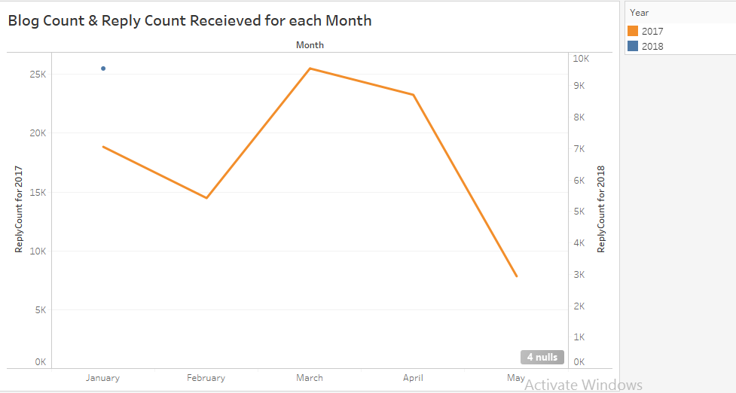
REPLY COUNT FOR MONTH WISE
Highest: March: 1071064
Least: May: 0

Slide 14
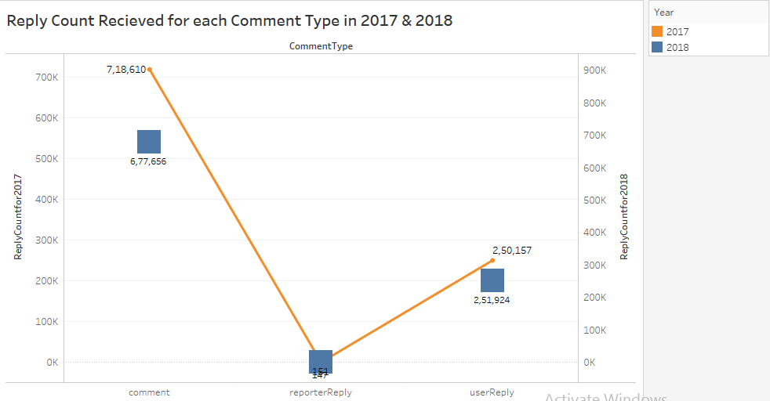
Reply count for each Comment Type in 2017-18

Slide 15
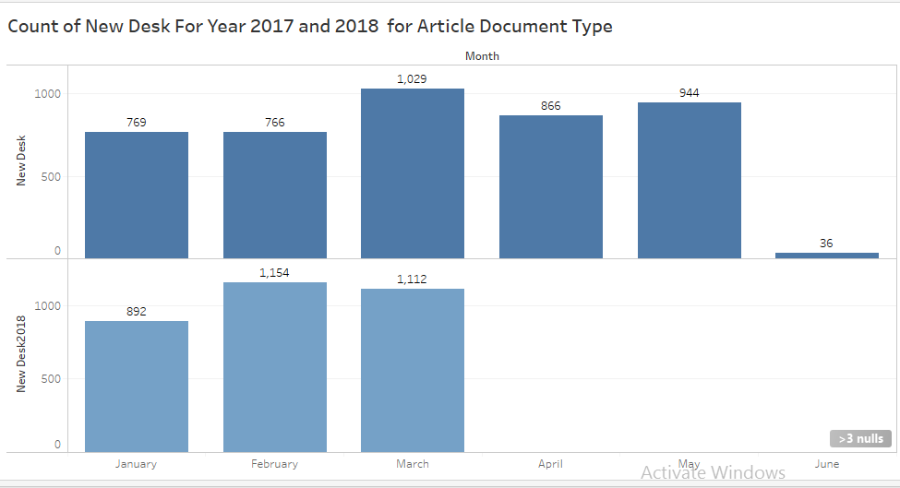
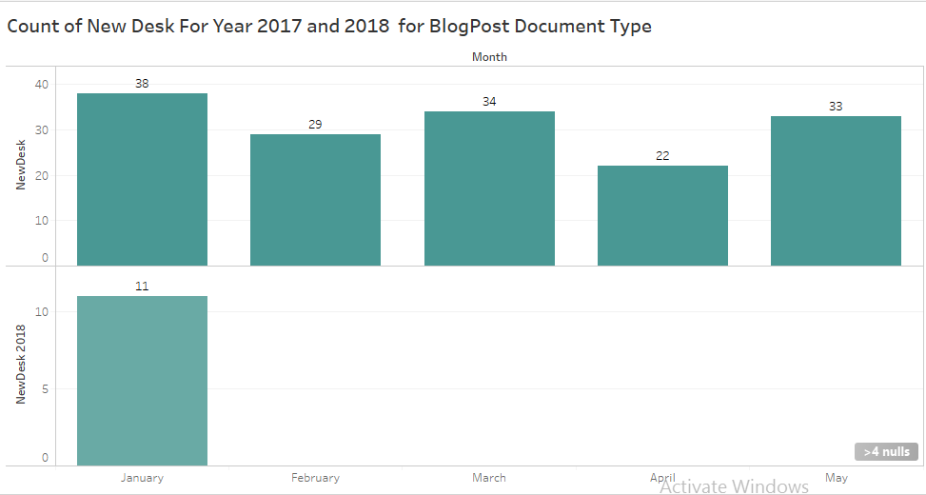
COUNT OF NEW DESK MONTH WISE

Slide 16
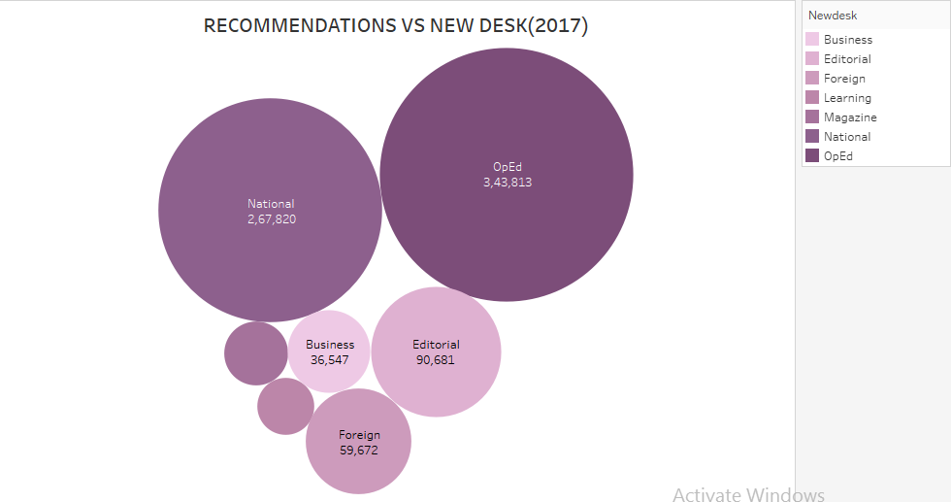
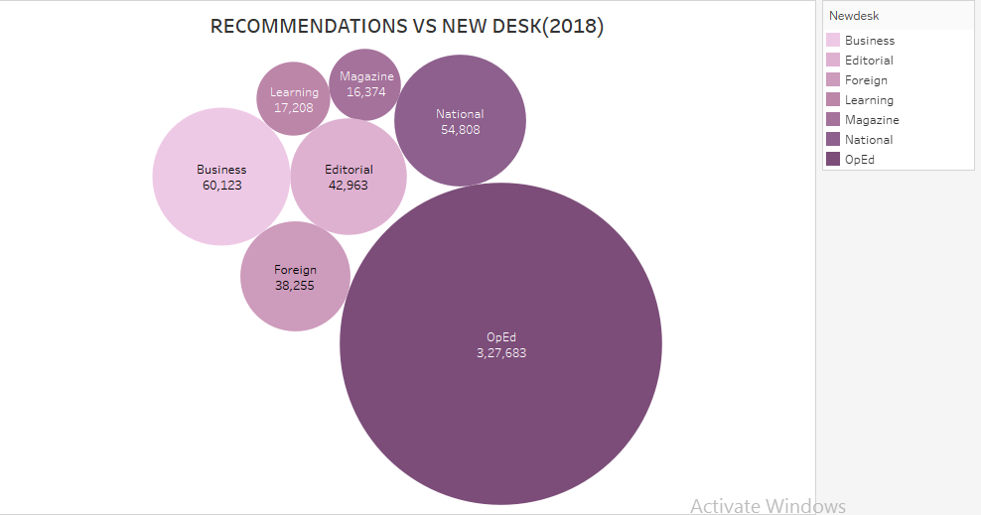
NEW DESK BASED ON RECOMMENDATIONS
Highest: OpEd
Increase in 2018: Business

Slide 17
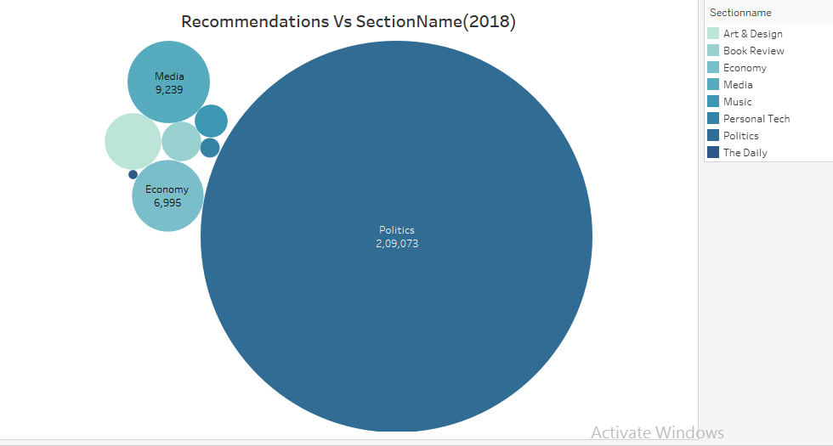
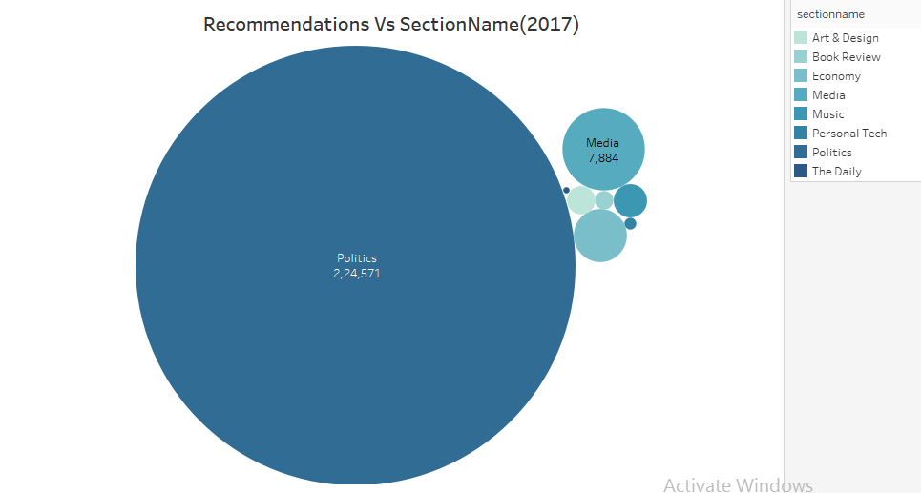
SECTION NAME BASED ON RECOMMENDATIONS
Highest: Politics
Increase in 2018: Economy

Slide 18
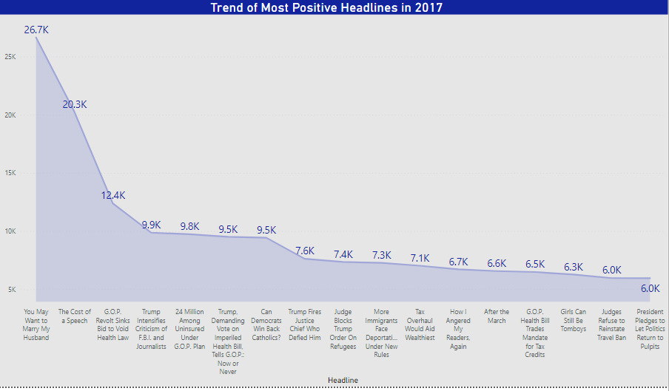
DEGREE OF POLARITY BY MOST POSITIVE HEADLINES

Slide 19
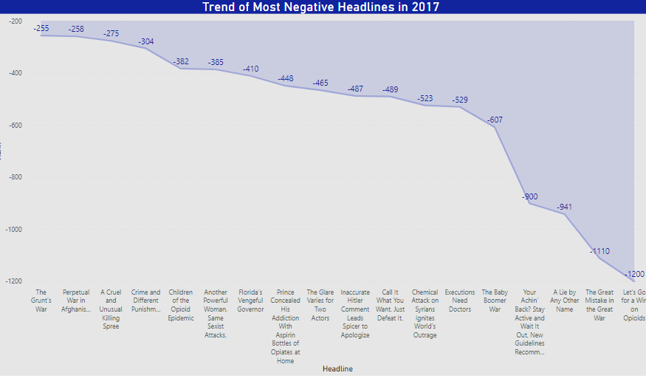
DEGREE OF POLARITY BY MOST NEGATIVE HEADLINES

Slide 20
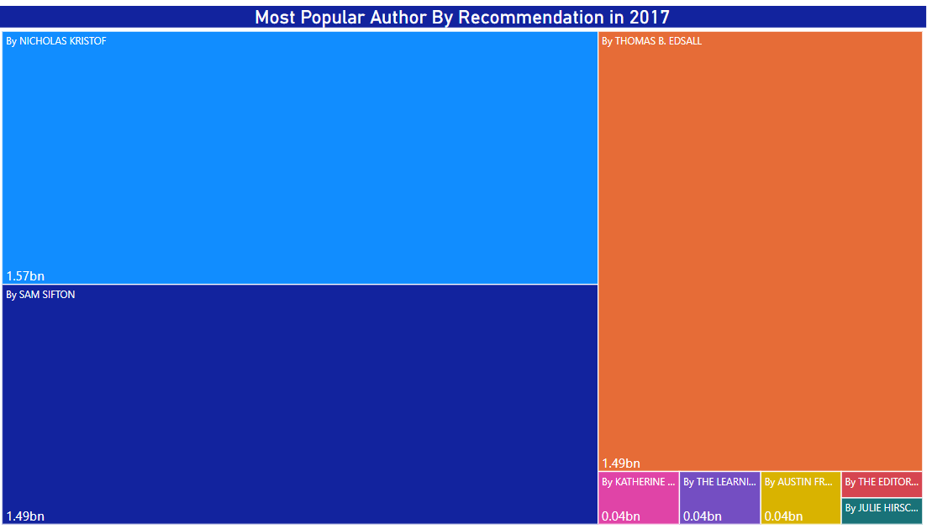
Most Popular Author (2017)

Slide 21
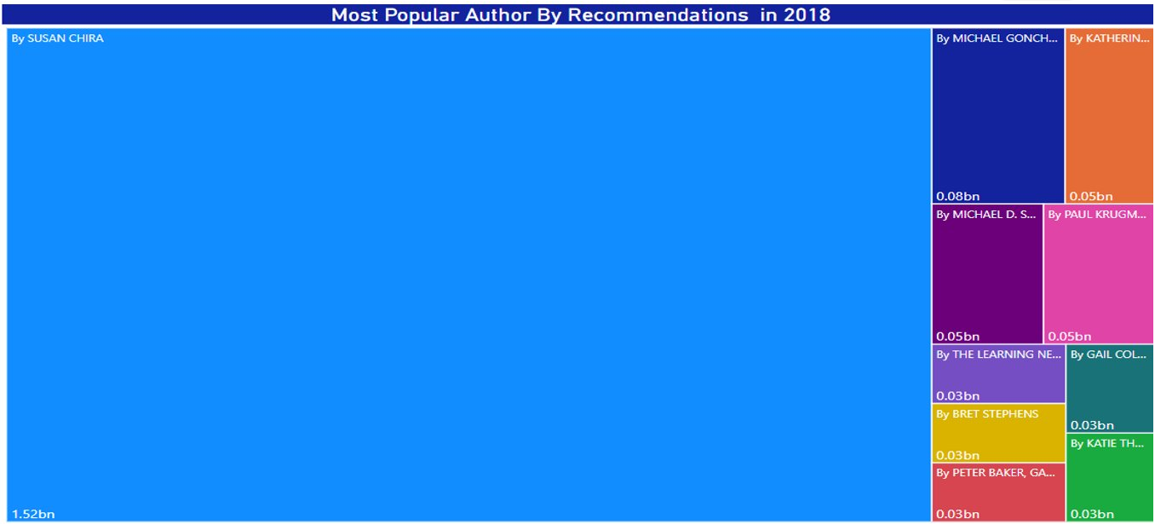
Most Popular Author (2018)

Slide 22
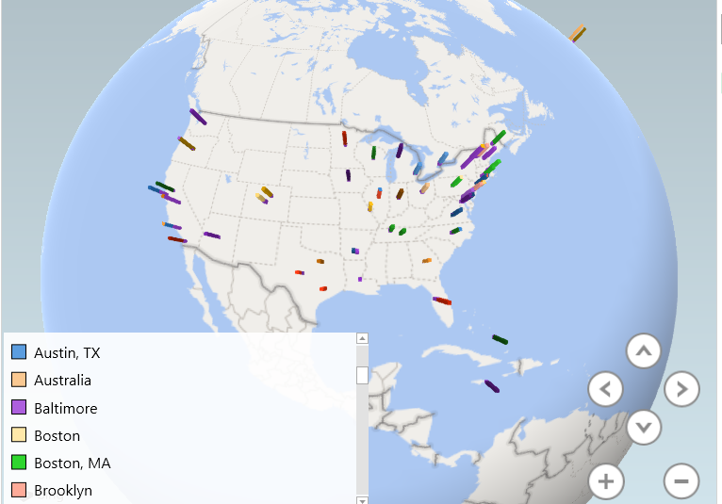
REPLY COUNT BY USER LOCATION FOR 2017
IMAGE
NY: 30,638
Cal: 15,273
Chicago: 12271

Slide 23

Video (2017)

Slide 24
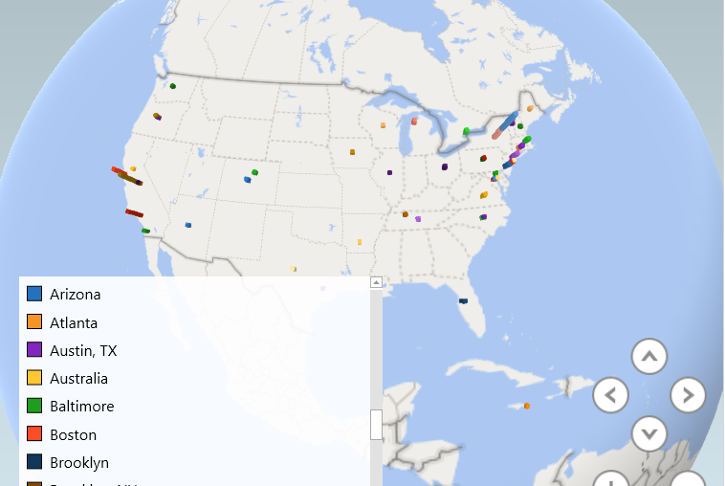
REPLY COUNT BY USER LOCATION FOR 2018
NY: 13990
Cal: 4251
Chicago: 3126

Slide 25
Video (2018)

Slide 26
LIMITATIONS
We had data for just first 5 months of 2017/2018 but not of the remaining months.
So cumulative analysis of an entire year say 2017/2018 could not be performed.

Slide 27
CONCLUSION
High article Count
In Articles Highest count is for News
Highest Active Reply Count: New York
Most popular author: (in 2017) Nicholas Kristof , Susan Chira (2018)
Sentiments

Slide 28

QUESTIONS

Slide 29

Thank You

